Slide 1
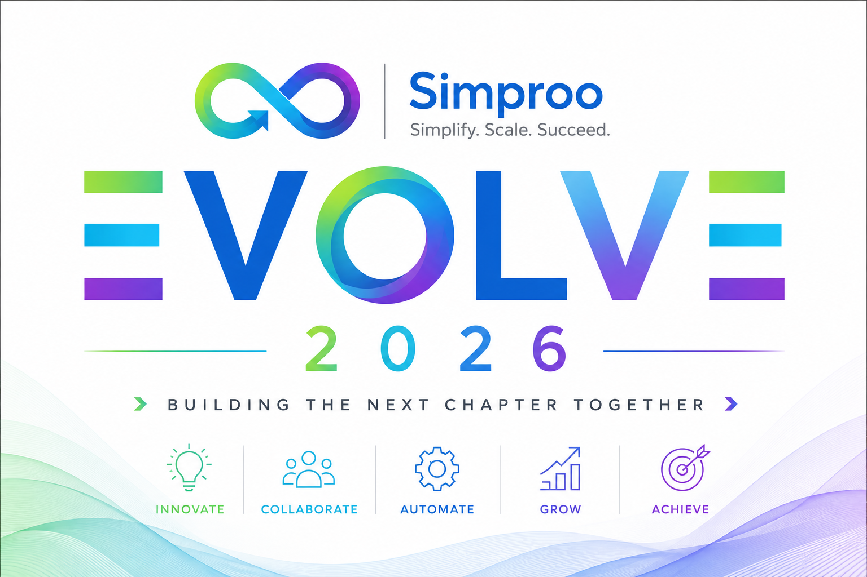

Slide 2
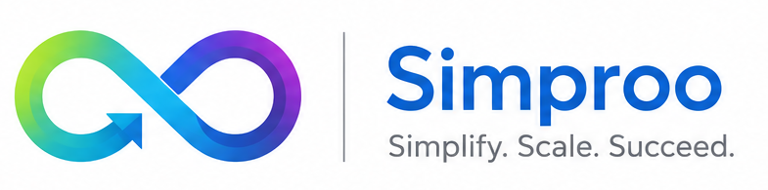
WHY NOW
Small teams can now compete through speed of learning, not size of organization.
$37B enterprise gen-AI spend
AI is an amplifier
Months, not years
Menlo Ventures reports 2025 enterprise generative AI spend grew from $11.5B in 2024 to $37B in 2025.
DORA 2025: AI magnifies existing organizational strengths and weaknesses.
YC notes AI enables small teams to ship thoughtful products to large organizations faster.
Implication: our bottleneck is no longer only technology access. It is clarity, ownership, quality, and learning.
Annual Day 2026 | From Average Team to High-Performance Product Team
Sources: Menlo Ventures 2025; DORA 2025; YC RFS

Slide 3
FUTURE LANDSCAPE
The next industrial problems will mix software, AI, hardware, trust, and operations.
AI-native development
Multi-agent systems
Physical AI
coding agents, evaluations, AI platforms
workflow automation with human guardrails
robots, devices, factories, sensors
Edge/local models
Preemptive security
Digital provenance
privacy, latency, offline intelligence
continuous defense and AI security
trust in data, media, and decisions
Future-ready is not trend-chasing. It is building teams that can sense, decide, ship, and learn.
Annual Day 2026 | From Average Team to High-Performance Product Team
Source: Gartner Top Strategic Technology Trends 2026

Slide 4
TOP 10 TECHNOLOGY TRENDS
Gartner 2026 trends point to one message: AI needs foundations, orchestration, and trust.
AI foundations
AI orchestration
Trust and governance
AI-native dev platforms
Multiagent systems
Preemptive cybersecurity
AI supercomputing platforms
Domain-specific language models
Digital provenance
Confidential computing
Physical AI
AI security platforms
Geopatriation
Simpro takeaway: do not chase every trend. Build the platform, data, security, and learning foundations that let us absorb the right trends faster.
Annual Day 2026 | From Average Team to High-Performance Product Team
Source: Gartner Top 10 Strategic Technology Trends for 2026

Slide 5
EXECUTIVE SUMMARY
The goal is not more process; the goal is a stronger operating system.
1. Small team advantage
2. Culture is the multiplier
AI, cloud, open source, and automation have lowered the barrier to serious product building.
Ownership, accountability, psychological safety, and learning determine whether tools create value.
3. Growth engineering connects the story
4. Team leads run the loop
Customer signal becomes product bet, experiment, release, measurement, learning, and scale.
Context -> Commitment -> Action -> Evidence -> Refinement.
Today is a workshop, not a speech with chairs.
Annual Day 2026 | From Average Team to High-Performance Product Team

Slide 6
STORY SPINE
The whole story is one loop: value, growth, trust, and learning reinforce each other.
Customer
signal
Product
bet
Growth
experiment
Engineering
execution
Secure reliable
release
Evidence and
learning
Nothing is separate: product chooses the bet, growth engineering tests it, engineering makes it real, DevSecOps/SRE protect trust, metrics teach us what to refine.
This is the song: each section returns to the same rhythm.
Annual Day 2026 | From Average Team to High-Performance Product Team

Slide 7
CULTURE SHIFT
The transformation is from ticket execution to outcome ownership.
Average team
High-performance team
Receives tasks
Owns outcomes
Optimizes local output
Optimizes customer value
Tests late
Builds quality in
Escalates surprises
Makes risk visible early
Learns occasionally
Learns every week
Annual Day 2026 | From Average Team to High-Performance Product Team

Slide 8
AGILE AS BEHAVIOR
The human side of Agile is values lived under pressure.
Commitment
We choose meaningful goals and follow through.
Focus
We reduce noise so important work can finish.
Openness
We surface truth early, especially bad news.
Respect
We challenge ideas without attacking people.
Courage
We speak up, simplify, and change direction when evidence demands it.
Agile is not softer management. It is faster truth with more responsible people.
Annual Day 2026 | From Average Team to High-Performance Product Team
Sources: Scrum Guide 2020; Agile Manifesto

Slide 9
OWNERSHIP
High performance needs psychological safety and accountability together.
High safety
Comfort zone
Learning zone
Nice people, weak follow-through.
Speak truth, take ownership, improve the system.
Apathy zone
Anxiety zone
Silence, delay, low energy.
Pressure without voice. People hide risk.
Low safety
Low accountability
High accountability
Target: high standards without fear.
Annual Day 2026 | From Average Team to High-Performance Product Team
Sources: Amy Edmondson; Google re:Work

Slide 10
ACCOUNTABILITY
Ownership is a ladder: from waiting for instructions to improving the system.
Reflection: where do we usually operate when pressure increases?
6
I improved the system
5
I owned the outcome
4
I proposed options
3
I found the risk
2
I did my task
1
I was told
Annual Day 2026 | From Average Team to High-Performance Product Team

Slide 11
LEADERSHIP OPERATING RHYTHM
Team leads convert intent into a weekly learning loop.
Context
Commitment
Action
Evidence
Refinement
Why this matters
What outcome we choose
What we do now
What changed
What improves next
Team lead question: what evidence would prove this week mattered?
Annual Day 2026 | From Average Team to High-Performance Product Team

Slide 12
PRODUCT MINDSET
Build the right product by connecting customer value, business value, and technical possibility.
Desirable
for users
Viable
for business
Feasible
with tech
Empowered teams solve problems, not just deliver feature lists.
Annual Day 2026 | From Average Team to High-Performance Product Team
Sources: SVPG; IDEO design thinking

Slide 13
WORKSHOP
Exercise: turn a request into a product bet.
Request
Product bet
"Build a manager dashboard"
User -> problem -> outcome -> metric -> smallest experiment
Best answer starts with a human problem, not a screen.
Annual Day 2026 | From Average Team to High-Performance Product Team

Slide 14
GROWTH ENGINEERING
Growth engineering turns product thinking into measured learning.
Signal
Hypothesis
Experiment
Instrument
Measure
customer, sales, support,
usage, market
we believe X will
improve Y
smallest useful test
or release
events, logs, funnel,
quality signals
activation, retention,
revenue, reliability
Scale or stop
double down, refine,
or kill
Growth engineering is not only marketing. It is product + engineering + data + experimentation.
Small company version: one clear hypothesis, one instrumented experiment, one decision every week.
Annual Day 2026 | From Average Team to High-Performance Product Team
Inspired by product growth loops, lean startup experimentation, and DORA learning loops

Slide 15
MEASUREMENT BRIDGE
Growth metrics should connect product value with engineering health.
Product / growth signals
Engineering health signals
Activation
Lead time
Retention
Deployment frequency
Adoption
Change failure
Conversion
Recovery time
Support pain
Performance
Customer time saved
Security findings
Do not celebrate growth that damages trust. Do not celebrate engineering health that creates no customer value.
Annual Day 2026 | From Average Team to High-Performance Product Team

Slide 16
PLATFORM + GROWTH STRATEGY
Platform engineering makes growth experiments cheaper, safer, and repeatable.
Reusable
platform
Developer
flow
Faster
experiments
Product
growth
Customer
trust
templates, CI/CD,
observability, security
less setup, less toil,
smaller batch size
feature flags,
instrumentation,
rollback
activation,
adoption,
retention
quality,
security,
resilience
Small company leverage: build once, reuse often, measure always.
Platform is not a department. It is how we stop paying the same friction tax every project.
Annual Day 2026 | From Average Team to High-Performance Product Team

Slide 17
FOUNDATIONS
Doing the basics right is how small teams earn market-leader trust.
Product clarity
Quality
Security
problem, outcome,
metric
tests, review,
DoD
secrets, access,
data
Resilience
Cost control
Developer productivity
observability,
incident learning
cloud, AI,
ownership
golden paths,
automation
Foundations are boring like brakes are boring: you notice their strategy when they are missing.
Annual Day 2026 | From Average Team to High-Performance Product Team

Slide 18
ENGINEERING EXCELLENCE
Build it right by stacking quality into the workflow, not bolting it on later.
Customer promise
Usability and accessibility
Security and privacy
Performance and reliability
Tests, review, CI/CD
Simple maintainable design
When quality is late, everything becomes expensive.
Annual Day 2026 | From Average Team to High-Performance Product Team

Slide 19
INDUSTRY PRACTICE
Fast release cultures reduce batch size, automate safety, and learn from production.
Flickr
Amazon
Netflix
Meta
10+ deploys/day
11.6 sec avg
1000s/day
diffs every few hours
Dev and Ops cooperation
small services, automation
Spinnaker, canaries
small incremental changes
Lesson for us: do not copy deployment counts; copy small changes, automated checks, fast rollback, and shared ownership.
Annual Day 2026 | From Average Team to High-Performance Product Team
Sources: Netflix TechBlog; Thoughtworks; Meta Engineering; Flickr Velocity

Slide 20
MEASUREMENT
DORA metrics are a dashboard for conversation, not a stick for punishment.
Lead time
Deployment frequency
Are we waiting too much?
Can we release safely?
Change failure
Recovery time
Are changes hurting users?
Can we restore trust fast?
The question is not 'who made the number bad?' It is 'what system constraint is visible?'
Annual Day 2026 | From Average Team to High-Performance Product Team
Source: DORA

Slide 21
SECURITY
DevSecOps means trust is designed, checked, released, and operated continuously.
Design
Code
Build
Test
Release
Operate
threats
review
scan
risk
control
detect
Minimum for us: secrets, dependencies, access, logging, rollback, and AI-data boundaries.
Humor with a serious face: security at the end is a seatbelt after the accident.
Annual Day 2026 | From Average Team to High-Performance Product Team
Sources: NIST SSDF; OWASP

Slide 22
EVERYONE'S ROLE
A product culture has no spectators; everyone owns part of value and trust.
Developer
QA
IT admin
simplicity, review, tests, observability
risk lens, exploratory testing, quality coaching
access, environments, resilience, automation
Operations
Stakeholder
Team lead
flow, incidents, support signals
problem clarity, fast feedback, tradeoffs
context, commitments, evidence, refinement
Reflection: which handoff creates the most delay or misunderstanding today?
Annual Day 2026 | From Average Team to High-Performance Product Team

Slide 23
WORKSHOP
Exercise: diagnose a product incident without blame.
We shipped the requested feature. Users are confused. Performance is slow. Sales demo in 2 hours.
Product
UX
Dev
Was this the right problem?
Could users understand the flow?
What complexity did we hide?
QA
Ops
Security
Which risk did we miss?
Can we observe and recover?
Any trust or data concern?
Best answer: reduce impact, communicate, learn, and improve the system.
Annual Day 2026 | From Average Team to High-Performance Product Team

Slide 24
COMMITMENT
The session should end with a 30-day operating experiment, not applause only.
Start
Stop
Measure
Experiment
Review
one behavior
one habit
one signal
one trial
July 25
One owner. One metric. One review date. Keep it small enough to actually happen.
Annual Day 2026 | From Average Team to High-Performance Product Team

Slide 25
High performance is not a slogan.
It is the habit of turning truth into improvement.
Context -> Commitment -> Action -> Evidence -> Refinement
June 25

